Slide 1

BlockFighting with a HOOKER
(K2) ktwo@ktwo.ca
Shane.Macaulay@IOACTIVE.com
BLOCKFIGHTER II (@DEFCON24 #w00w00 #Blah!)
Notes:
v

Slide 2
What are we doing here?
Methodology & tools for high speed comprehension binary trace/analysis/steering
Super simple to use and FUN!
Monitor and Alter execution
BlockFighters
ROP DEFENDER
RAN$OM E$CROW
I HAVE A CERTAIN SET OF SKILLS
EhWinAFL
Almost defiantly not the best backend ever ;(
Hyepervisor DoS / detection!
Execution Graph tools
Block views Also + disassembly FLAME GRAPH!

Slide 3
Intro/Outline
Hooking/Tracing
Trace: What is executing?
Hooker: Can we also modify/detour flow?
Frustrations/Hurdles
What worked, what didn’t work, what also works ;)
Friendly inputs
Symbol support
Evil inputs

Slide 4
Intro: Current & OTHER / TOOLs / CODE
PRE-ALPHA!!!#(%@ check in is cowboy coding / lazy / uhhh ☺
https://Github.com/K2
Github.com/ShaneK2/inVtero.net
Evolution from CSW14 (process detection)
Cross platform (Windows, *BSD, Linux) memory analysis
Cross microarchitechture (sandy bridge, sky lake, …) 0
Cross hypervisor (based on auto-magic VMCS / EPTP extraction)
Includes nested support (D33P introspection)
EhTrace (pronounced “A Trace”)
What were going to cover this time DEFCON24!!! <<<⬅==============
Let me know if I missed any code in the check-in!!

Slide 5
Goals
Trace or Modify execution
Bare metal
Can run under a hypervisor
Binary steering
This method (EhTrace) does not require multiple executions
Using profiling hardware supported logging is faster at run time yet slower in some cases due to requiring us to re-run our target
EhTrace in a DBI – for fuzzing?
Maybe in the cloud or malicious binaries
Benign binaries check out Richard Johnson’s work “Go Speed Tracer”
Let’s see what AFL does in any event (hohooooo)

Slide 6
Dreams
Fun sandbox that is flexible and easy to play with
Lots of blockfighters
Swiss Army stuff
Defend against mal-code
Attack to understand anything
Uber perf
Slicing is your friend
Kernel look

Slide 7
Dependencies
I use Windows 10 x64
Cloud / older versions YMMV
Thanks Feryno
http://x86asm.net/articles/backdoor-support-for-control-transfer-breakpoint-features/
https://github.com/K2/EhTrace/wiki
Thanks InGap Jeong (laughfool)
http://fdbg.x86asm.net/add_debugctl_support_ws2008R2_w7.UEFI.BIOS.ver048.zip
For detail information's check below link. http://fdbg.x86asm.net/debugctl.article.txt

Slide 8
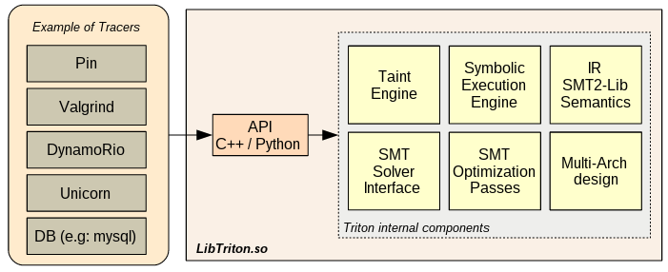
More References
Danny Quist, Valsmith – DEFCON15
http://www.defcon.org/images/defcon-15/dc15-presentations/dc-15-quist_and_valsmith.pdf
Covert debugging / vm / debugger detection & countermeasures
Page fault assisted “Saffron”
Super modern stuff => http://triton.quarkslab.com/ (seems like ideal design! ☺?.. hosted on github, (also since lots of darpa challengers do binary trace… Trail Of Bits GRR & tools)
Speed taint,
dynamic symbolic execution,
replay trace’s with snapshot,
SMT/constraint solvers, AST logic,
tracer independent & pythong

Slide 9
Traditional Trace Techniques
If hooking -- disassembly required
Insertion of a “detour” we need to know how to insert a trampoline
Stack stuff “arguments(A,B);”
Replicate instructions
Slow
Debuggers – EhTrace is sort of an in proc debugger
Less context switching and avoids having to use based pointers everywhere ☺
Disassembly needed for some circumstances, not explicit requirement
Thanks to capstone this is not a hard problem
Perf is an ongoing thing

Slide 10
Hooking execution
Detours
Requires an instruction length decoder
Rewrites function prolog into a specialized function which performs logging, analysis etc…
Usually static, can be dynamic/jitter,
may jmp to a leaf like detour which can work without knowing the function prototype/stack requirements
Most of the time you will need symbols or really good logic in the hooker to not break execution
Perf not perfect since were blowing shared cache, adding code and may require more

Slide 11
What’s the problem again?
Debuggers are slow, really slow
Second process context switching is fairly expensive
Logic for conditional breakpoints is exponentially more expensive
Being detected by EVIL c0d3
Checksums
Malicious binaries often checksum their code to validate they are not being analyzed
Highly secure environments may checksum their binaries to make sure they are not tampered with

Slide 12
Perf
Cost is mostly setting up the exception pump
logging(trace), RoP defender & Key Escrow very cheap on top of A pump ;)
Microbenchmarks show between 20-150% performance hit
TODO: Cache / Checkpoint implementation
Dynamically turn on/off depending on needs
Detect self-modifying code & otherwise adversarial stuff
TBH un-sliced hookers looking at 1000% TOTAL worst case, hey one order of magnitude is better than 2+!!
Theoretically can execute faster than native execution
Sort of the purpose of some of these trace interfaces to accelerate slow code or to bypass calls which can be simulated in a mem-cache
Eternal Space/Time trade off exercise left to an exercise by the reader

Slide 13

EhTrace
Aboot time for a trace eh?
Whatever I’m dual citizen
Uses VEH under the covers
Need to be a little careful
Don’t want to alter or change
behavior of what were looking at

Slide 14
Ret2 code
Original libc work, Solar designer
http://seclists.org/bugtraq/1997/Aug/63
Handy since most overflows contain a pointer to useful addresses
Your input
System libraries
Still used to this day (RoP)

Slide 15
Stack Hooking
Attempted to use as alternative to what we wound up using
From a second “manager” thread
Load from a RoP chain pool (memory area with RoP gagets)
Borrow memory from the executing stack from above the stack top
Usually some spare memory there
Not very great
Only post condition hooking
Have to find a way to get notification on new calls
Do some sort of shadow stack/memory protection trickery
Tends to be fairly fragile
UPDATE: Plan to use this method to configure checkpoints for enable/disable of tracing (huge perf boost and new functionality)
RET
RET
Notes:
Some fragments of this code is still in the github

Slide 16
EhTrace – how it works
LONG WINAPI vEhTracer(PEXCEPTION_POINTERS ExceptionInfo) {
// single step
ExceptionInfo->ContextRecord->EFlags |= 0x100;
// setup branch tracing
ExceptionInfo->ContextRecord->Dr7 |= 0x300;
Remarkably easy to trigger branch stepping of a binary
In the VEH handler set 3 bits and return.
THAT’S IT
TRAP FLAG
OTHER FLAGS :D

Slide 17
EhTrace – RoP Hooks
Register a VEH handler CreateRemoteThread(… &VeH_RoP,..);
VeH_RoP – use a RoP gadget finder (there are many)
Handler only needs to set the 3 bits then exit with continue status
Using the exception dispatcher were able to now get the preconditions we missed with the stack/shadow model
Pretty straight forward, just need to maintain control in flags since it’s cleared out of the context.

Slide 18
What else is it good for?
Branch stepping is pretty sweet!
A lot more than detours on functions
Basic block analysis
Code coverages
Can we put this into a DBI (Dynamic Binary Instrumentation) framework?
Do we need to emulate? Isn’t that slow?
If were dealing with a malicious binary we have several things to consider.
Of course we need to also watch out for an otherwise non-mal binary doing something that might disrupt our trace

Slide 19
Maintaining control
Maybe use page protection to force an exception on execution (don’t want to place an int3 obviously)
When page is attempted to be executed we check to see what emulation is needed
If somebody tries to take over VEH
What about intra-block stuff?
Can’t they just write over our VEH handler in memory?
Sure, maybe register 2! Also setup the VEH continue handler
Do some hybrid stack rewriting (inject LOP’s) + EhTrace to steer and manage target binary

Slide 20

Blockfighting with a hooker
BlockFighter has to be smart, fast and in total control!
Much like a StreetFighterII champ!

Slide 21
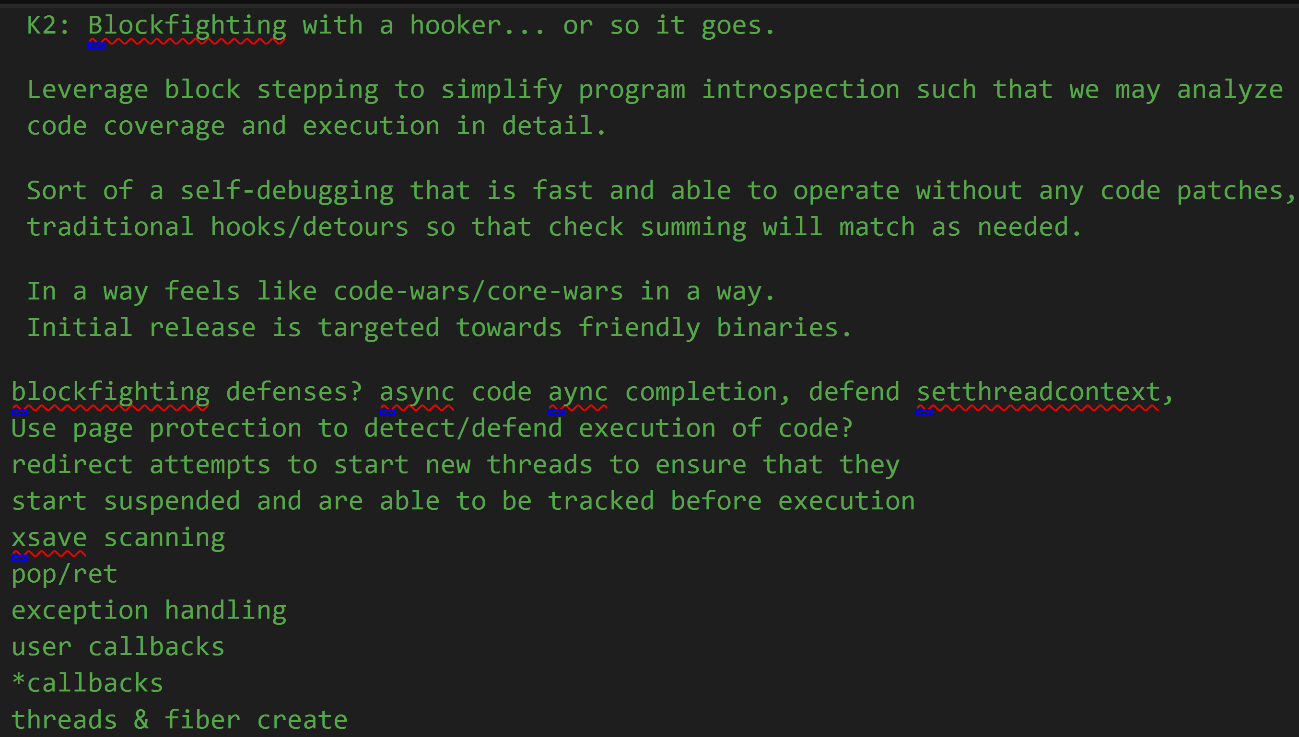
BlockFighting

Slide 22
BlockFighting
Simplified analysis
Using capstone we & the branch step
At the point of any jmp/ret/call control transfer we can stop our fight until the next round
Round 2 FIGHT!
Actually were so good we always “give second round”!
That means really that if there’s a conditional we need to follow through a conditional
Jne – we follow the non-jump to ensure we complete the context until a ret/jmp/call
Eventually add [RJL]oP engine and things get a lot more easy with binary steering… (perf good, nearly native speed, drop most exception overhead! ☺

Slide 23
BlockFighting
Watch the eflags & DR any manipulation will cause problems for us
DEBUG_MSR ?
Lots of things probably
Overall however we have a platform to build primitives on that can eventually do battle in a structured way
Maybe combine blockfighter with stack injection to ensure we have additional post-condition checks on our flag/branch-step/veh state

Slide 24
Ransom Warrior
Enforce cryptographic key escrow
Trace the binary
Escape random read’s => network, protected enclave / hypervisor assisted
Prototype block fighter can expand into a more refined set of interfaces
ROP / JOP / LOP Building got to love the lop op – LOP!

Slide 25
Coverage
Can you hear me now?
Flame graph
Current minimal state includes RIP, LAST_RIP, TID, FLAGS and ESP
This is sufficient to build any code graph! Intra-procedural, call graph or full trace
FLAMING BlockFighter!
http://www.brendangregg.com/FlameGraphs

Slide 26
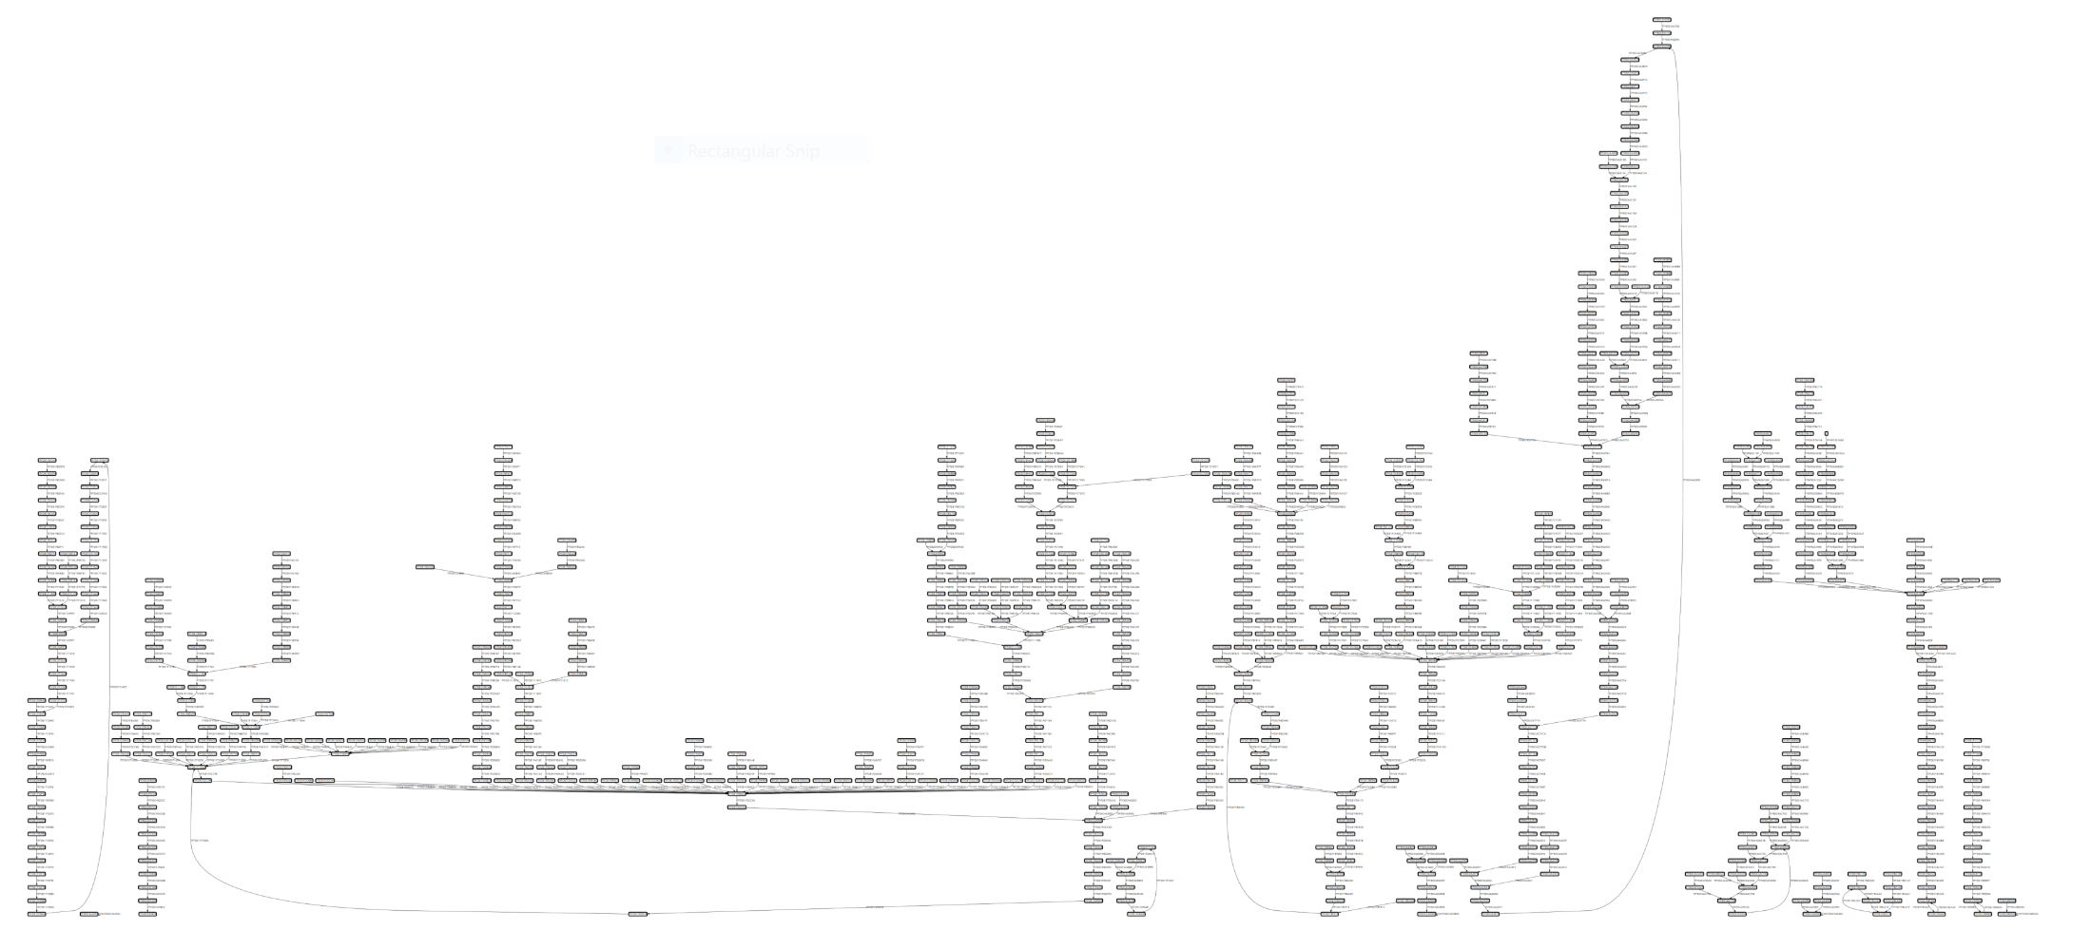
Execution history – Blocks

Slide 27
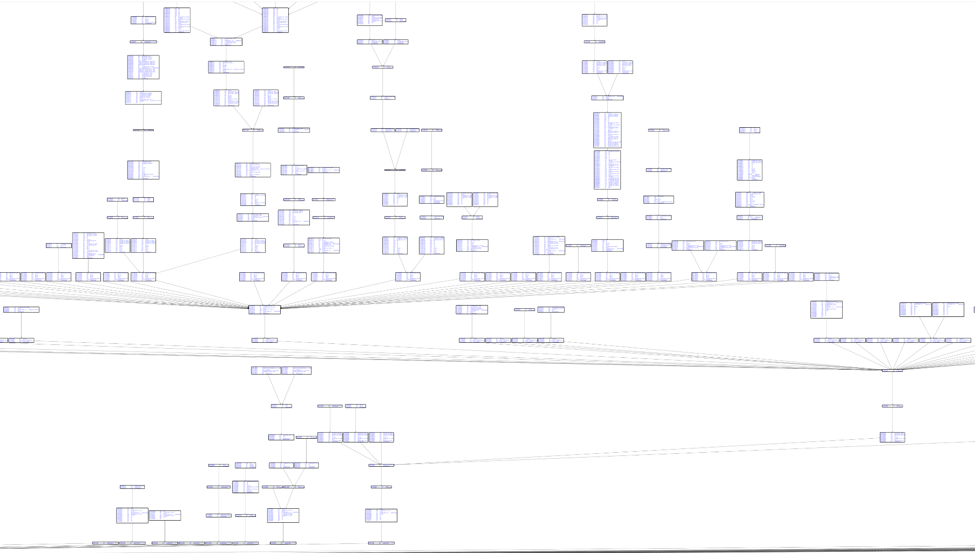
Execution history – With ASM

Slide 28
CPU FLAME GRAPH
CLICK HERE
Orig from here -> http://www.brendangregg.com/FlameGraphs/cpu-bash-flamegraph.svg
(PowerPoint doesn’t do SVG’z i.e. SVG is navigable)

Slide 29
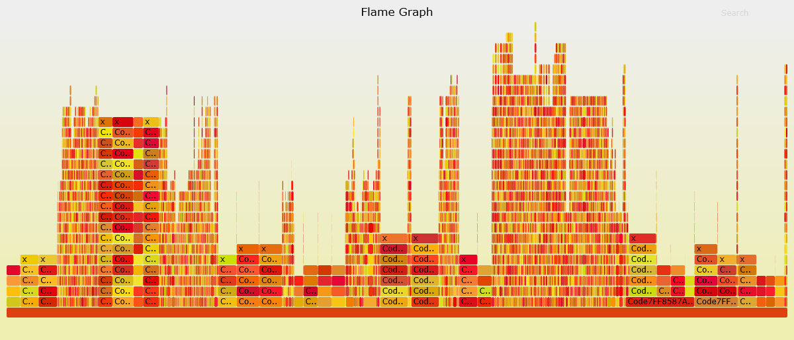
CPU FLAME GRAPH
https://github.com/K2/EhTrace/blob/master/support/x1_100k.png

Slide 30
Upcoming stuff…
MSAGL graphmaps – fun/interactive mesh graph, sort of looks like an expandable spiderweb!
SVG builder (without the .pl scripts from Brendan)
Tighter Symbols (graphs and images not as fun without English eh?)
Stack hooking to enable/disable
PE Analysis to improve exception handling (.pdata/.rdata can help tune/optimize)

Slide 31
Upcoming stuff: Blockfighters
A Flagfighter
Rflags checks
A PageFighter
Page protection monitor
E.g. protect the entrypoint CreateRemoteThread call’s before it calls the specified &func argument to detect remote threads before the DLL thread notification run’s
Use tricks like this to ensure your not being tricked yourself
Page fighter should be slicing the input based on what you want to trace (i.e. manage trace A B or C .DLL and leverage page protection as
Emu Fighter
Emulate an operation that would otherwise detect us

Slide 32
Private implementations differ!
Your fighters will be various
i.e. if your not using any system/runtime API you don’t need to worry about locking as much (obviously)

Slide 33
Questions -- DEMOz?
Feedback, bugs & Feature requests please
https://github.com/K2

Slide 34
Thank you

